Slide 1
Intro. To PID Controller Mohamed Saied

Slide 2
Agenda
Intro. To Open & Closed Loop Control Systems
What’s PID ?
PID Parameters
Proportional Action
Integral Action
Derivative Action
Pesudo code

Slide 3
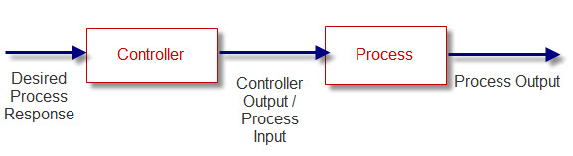
Open Loop System

Slide 4
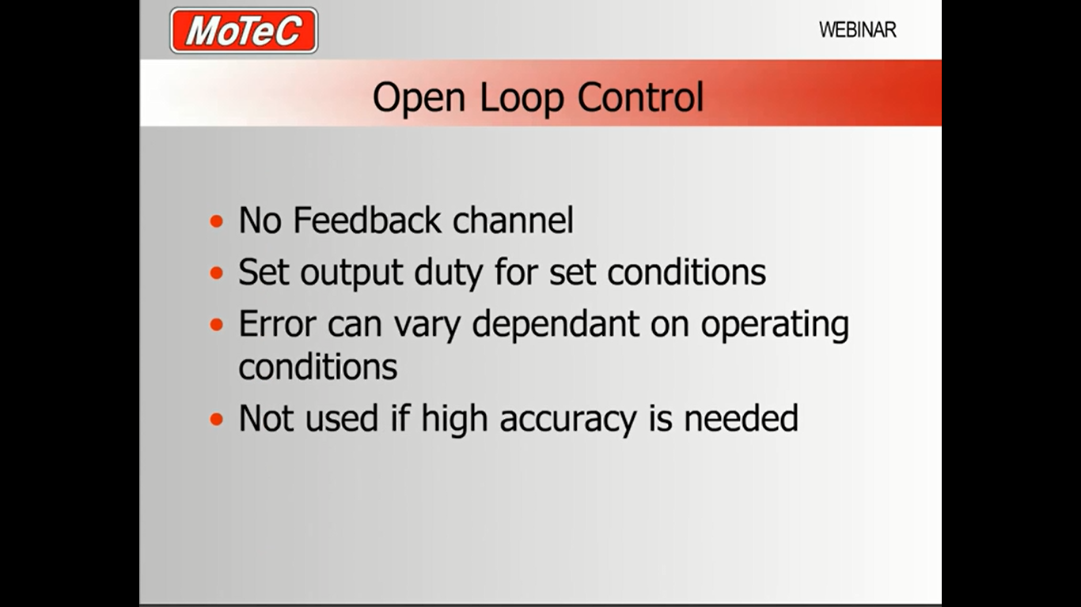

Slide 5
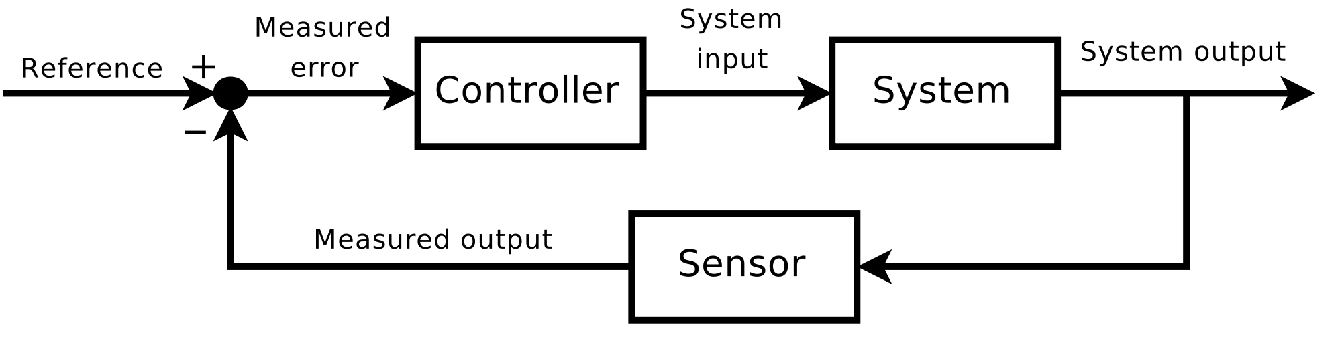
Closed Loop System

Slide 6
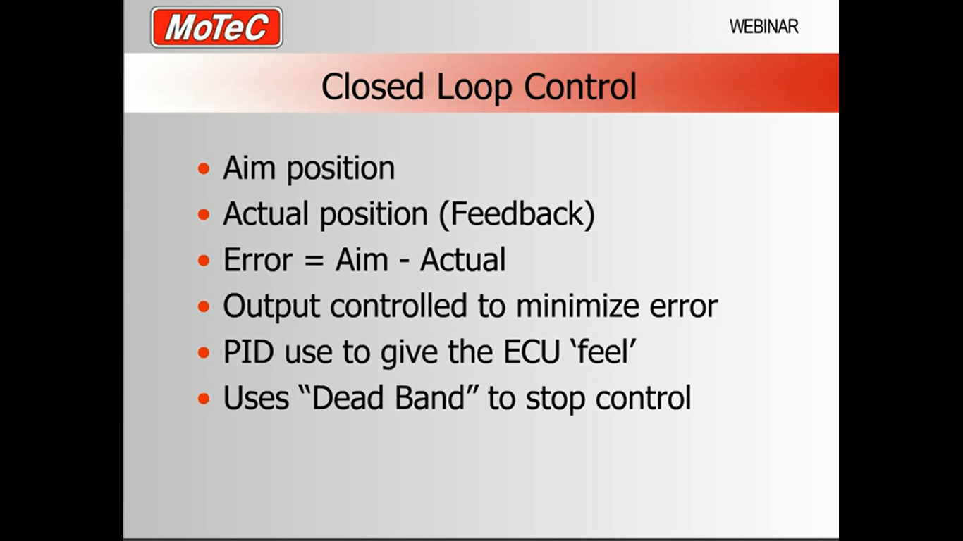

Slide 7
What’s PID ?
The PID controller is the most common form of feedback
PID controller is a control loop feedback mechanism widely used in industrial control systems
A PID controller calculates an "error" value as the difference between a measured process variable and a desired setpoint
The controller attempts to minimize the error by adjusting the process control output

Slide 8
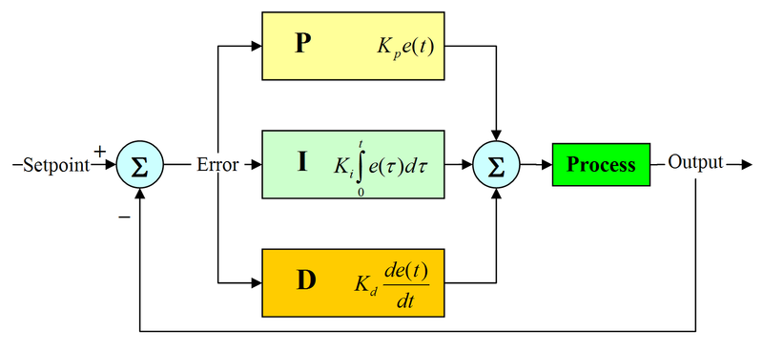
What’s PID ? (Cont.)

Slide 9

PID Parameters
Kp : Proportional gain, a tuning parameter
Ki: Integral gain, a tuning parameter
Kd: Derivative gain, a tuning parameter
e: Error = SP-PV
t: Time or instantaneous time (the present)
∆t: Variable of integration; takes on values from time 0 to the present .

Slide 10
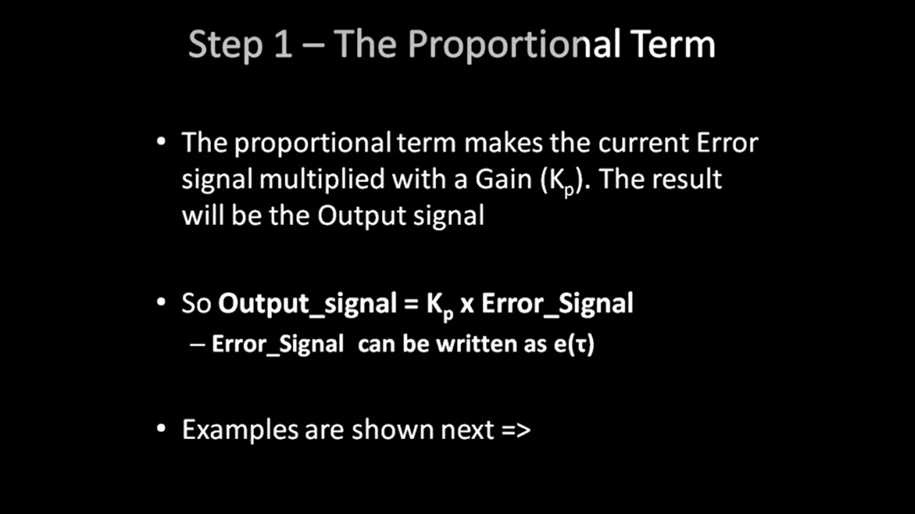
Proportional Action

Slide 11
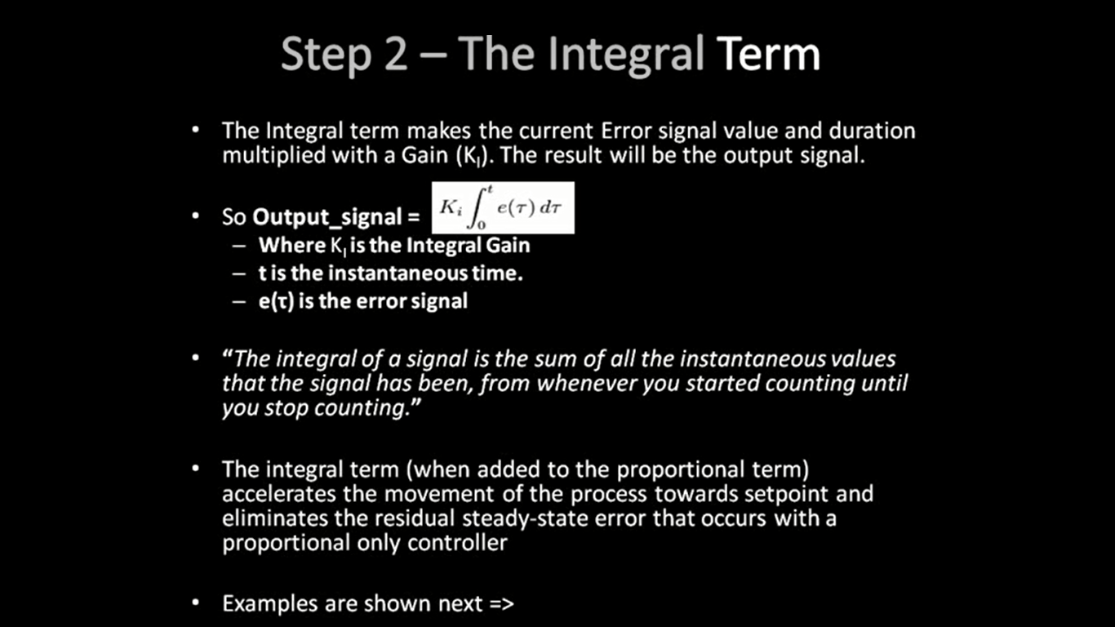
Integral Action

Slide 12
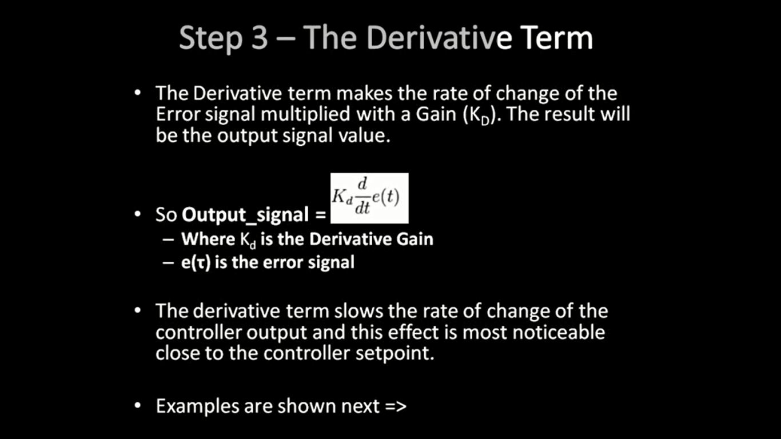
Derivative Action

Slide 13
Effects
Effect of higher Gain Kp
The speed of response is improved.
The percentage overshoot is increased.
The settling time is increased.
Effect of higher sampling time
Increase in percentage overshoot.
Increase in settling time.
Effect of higher Ki
Reduces steady state error.
Increases possibility of instability and oscillations.
Effect of higher Kd
No effect on Accuracy.
Increases high-frequency noise.
Has stabilizing effect.

